Slide 1
Covid-19 Restrictions
From May 24th
Indoor group exercise and training can resume
Includes soft play areas, leisure centres, gyms, swimming pools, equestrian centres, venues relating to motor sport and activity centres.
Numbers limited to suit the venue
Social distancing where possible
Risk assessment to maximum capacity
All contact details must be taken and retained
Indoor club training in squads allowed
No limits on numbers
Schools can resume extra-curricular activities
Indoor extra-curricular sports allowed

Slide 2
Clubs: Key Considerations
Appoint a Co-Vid Officer
Complete BI Risk Assessment
Contact Venue
Ensure Compliance With Protocols Before Reopening
Gather Contact Information For All Members
Club Night Scheduling/Records
Cleaning and Sanitising
One Parent Per Juvenile
Responsible For Enforcing Guidelines With Members
Face Coverings/Masks When Not Playing
Normal Play can resume ( Singles & Doubles) – ‘Pods of 8’

Slide 3
Coaches: Key Considerations
Must be a BI Licenced Coach
Develop And Prepare A Risk Assessment
Request Permission From Club/Venue
Liaise With Club/Venue On Cleaning and Set-Up Protocols
Online Payments

Slide 4
Coaches: Key Considerations
Coach operates outside of the pod so long as guidelines are adhered to
Enforce Physical Distancing
Face Coverings While Coaching
Maintain Attendance Records
Limit Coaching Equipment

Slide 5
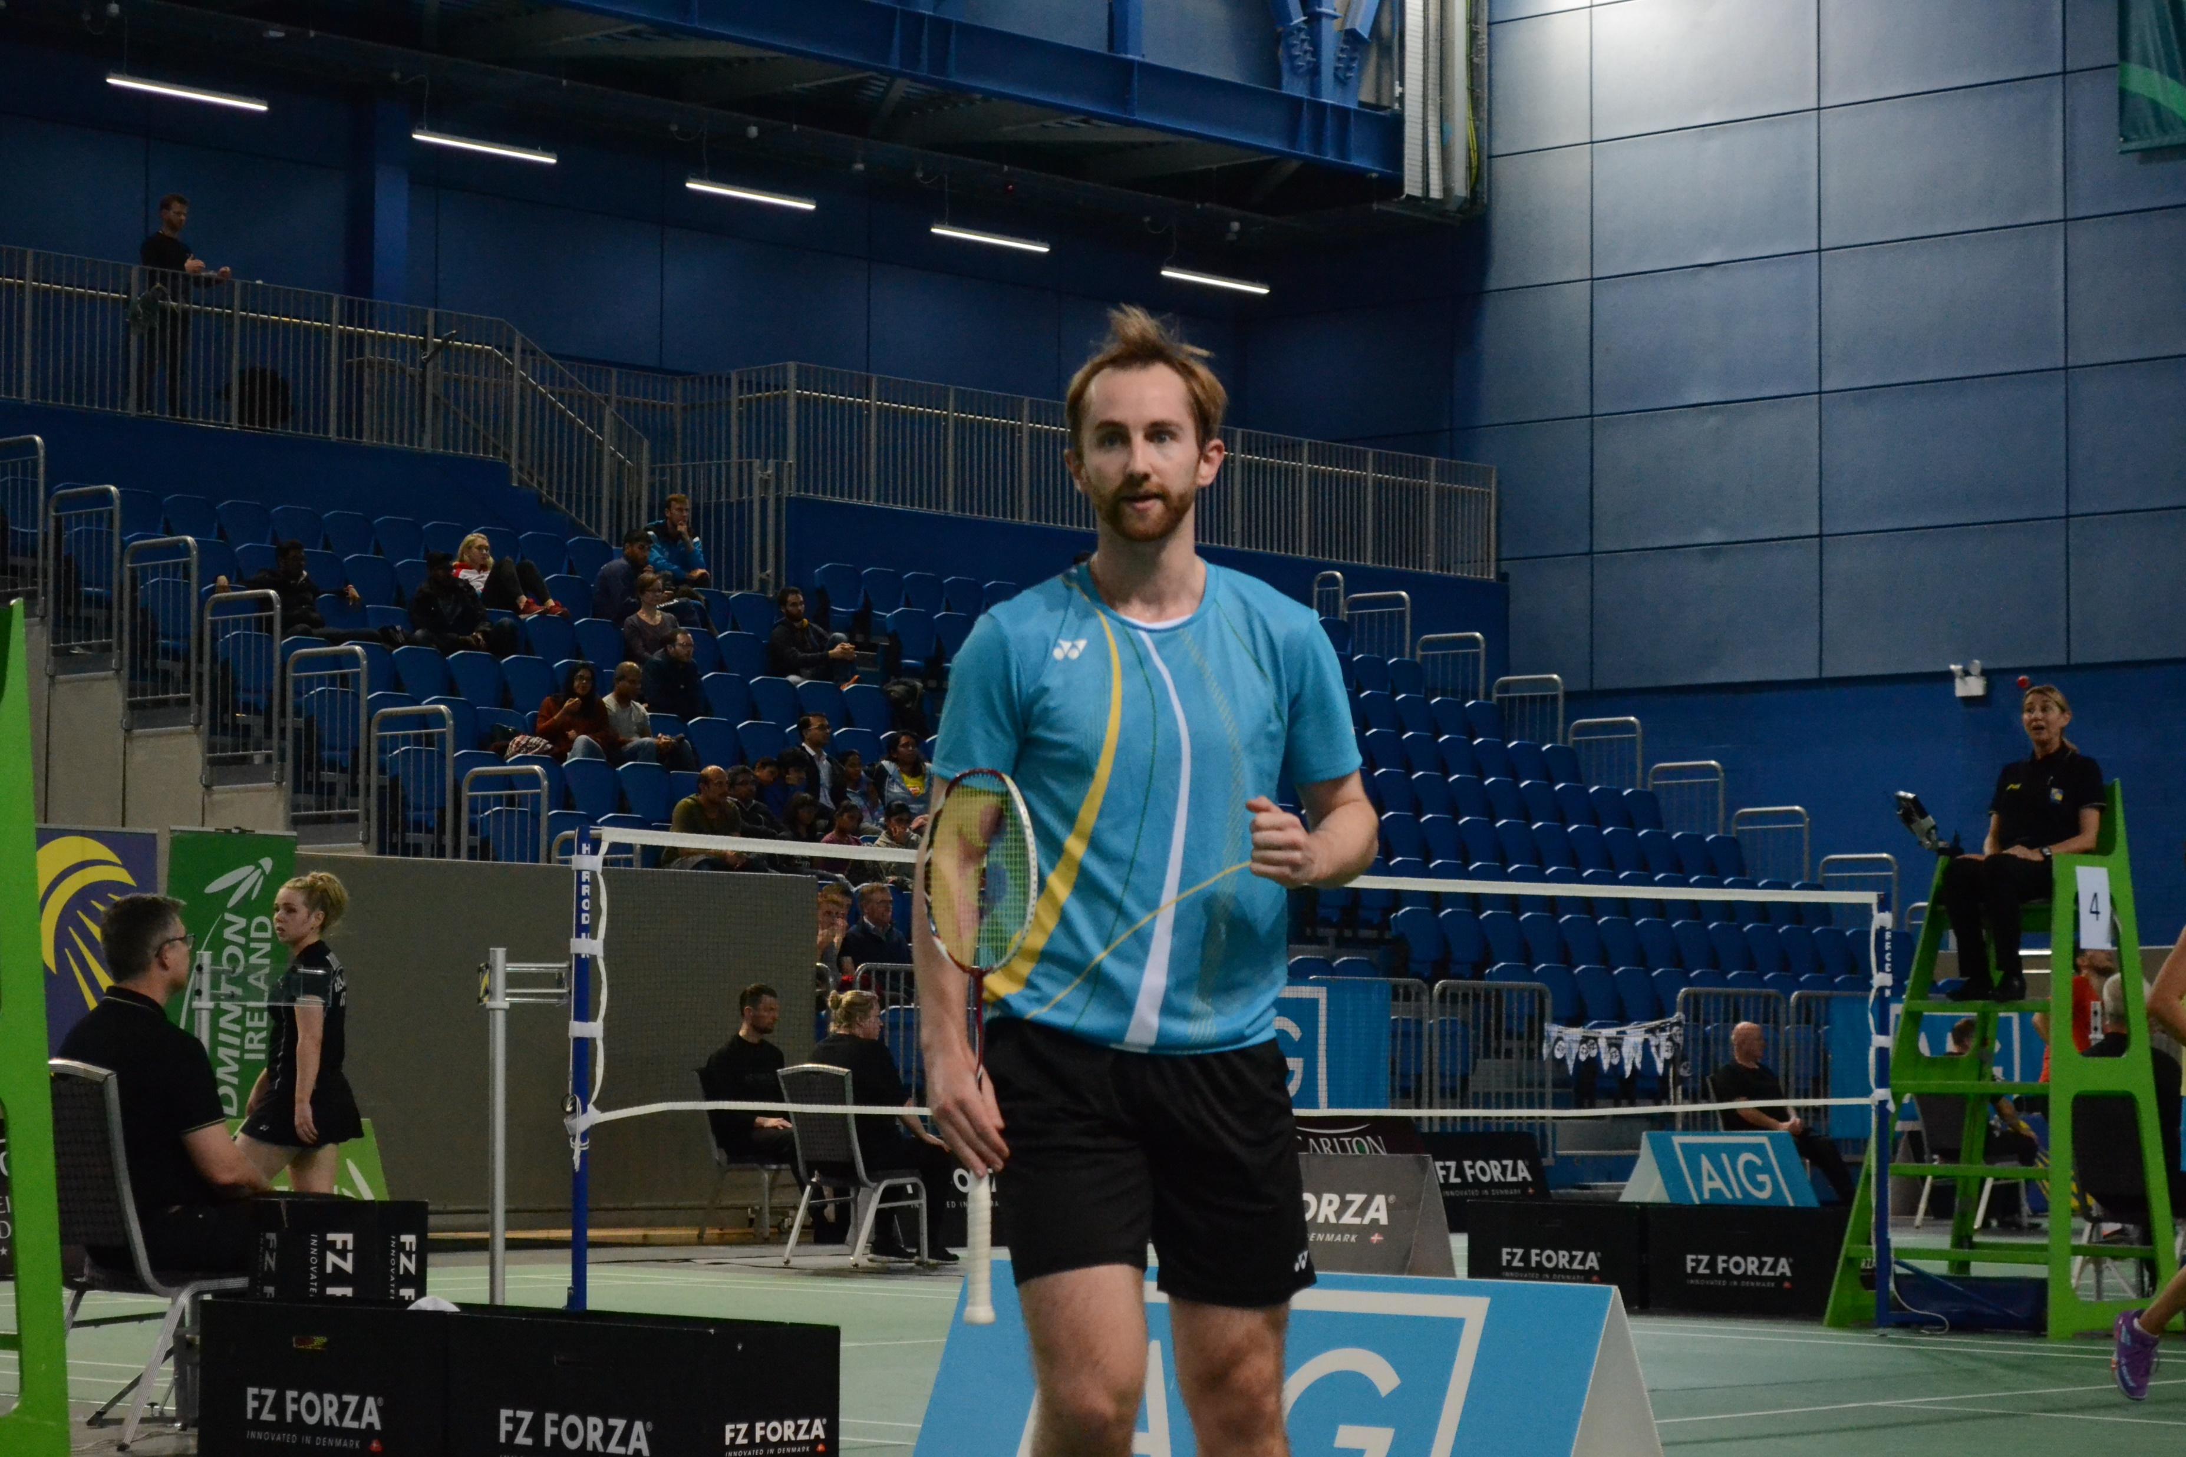
Players: Key Considerations
Before PLAYING
Check with GP if in High-Risk Category
Provide contact details to club
Stay at Home if;
In High-Risk Health Category
Displaying Co-Vid Symptoms
Abroad in last 14 Days
In contact with someone who has Co-Vid in last 14 days
Pre-arrange court slot with club
Travel alone to venue

Slide 6
Players: Key Considerations
AT THE VENUE
Arrive/Leave as close to playing times
Have consistent playing partners/pod
Enforce physical distancing
Do not share equipment
Refrain from excessive handling of shuttle
Kit/Equipment kept behind the court
Mask worn if in venue and on a break from playing
Gentle reminders to others
Contact GP post-session if unwell

Slide 7
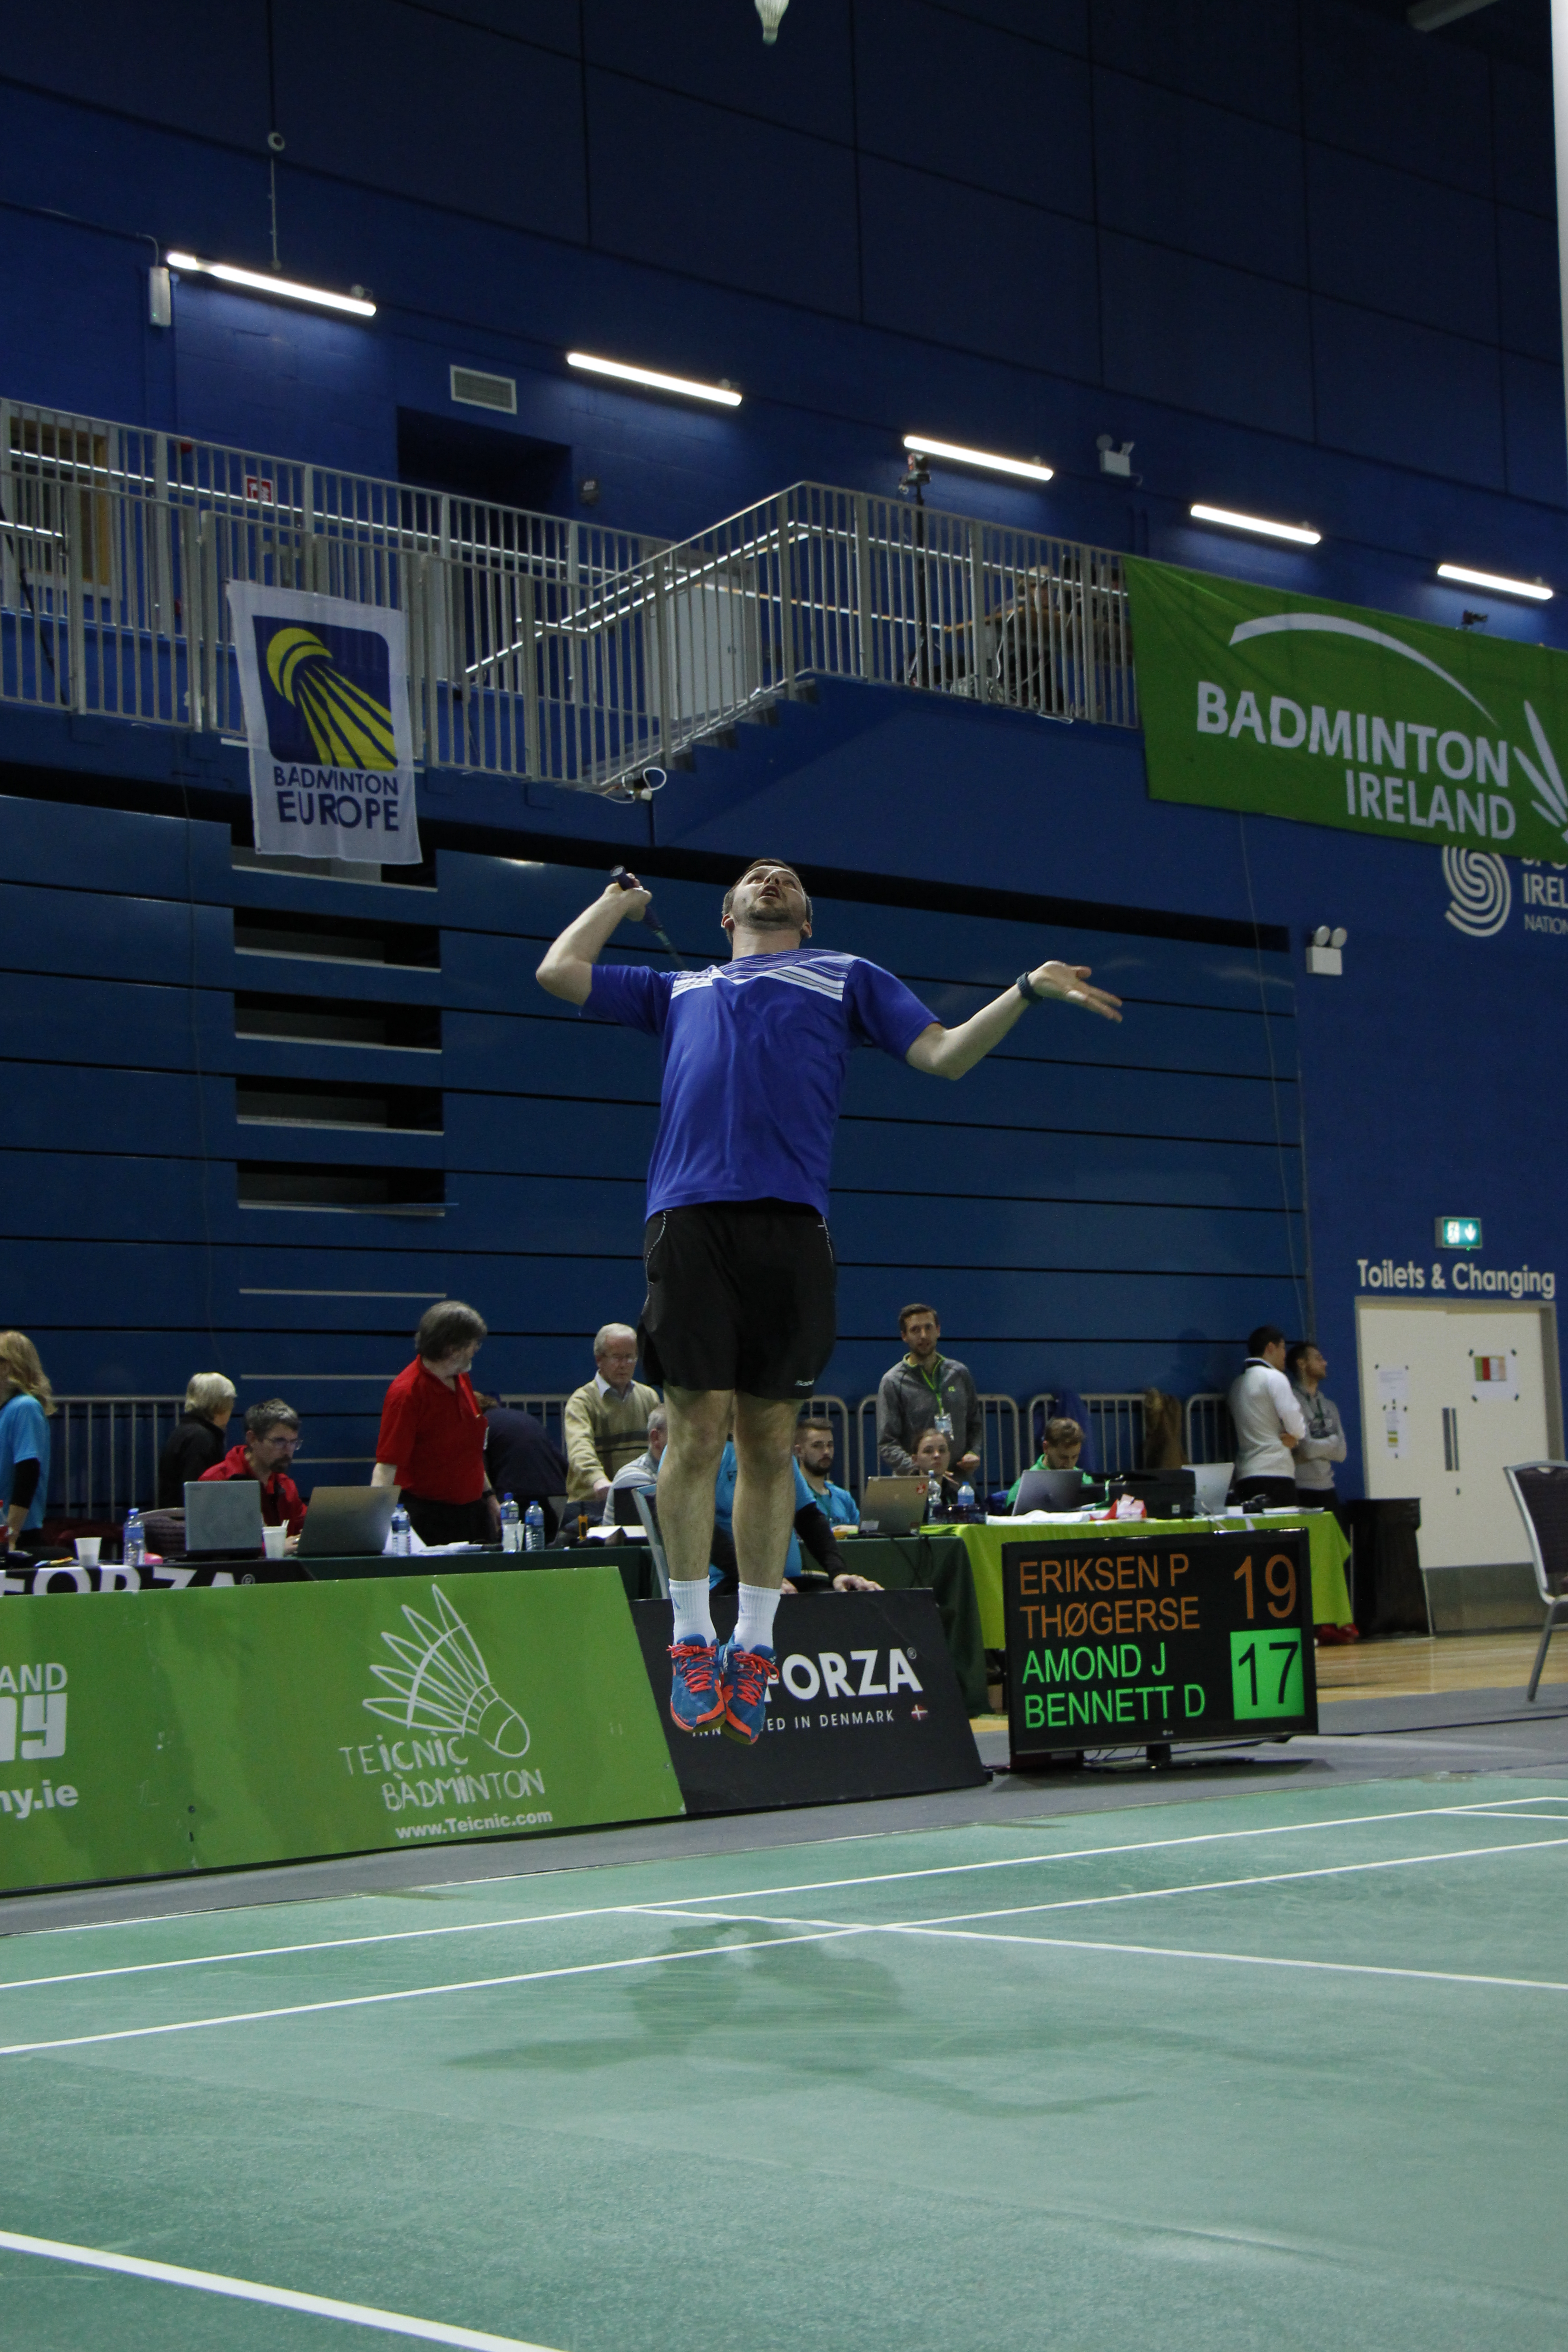
Key Changes
New variants
Ventilation
Shuttles
Vaccines
Updated Resources

Slide 8
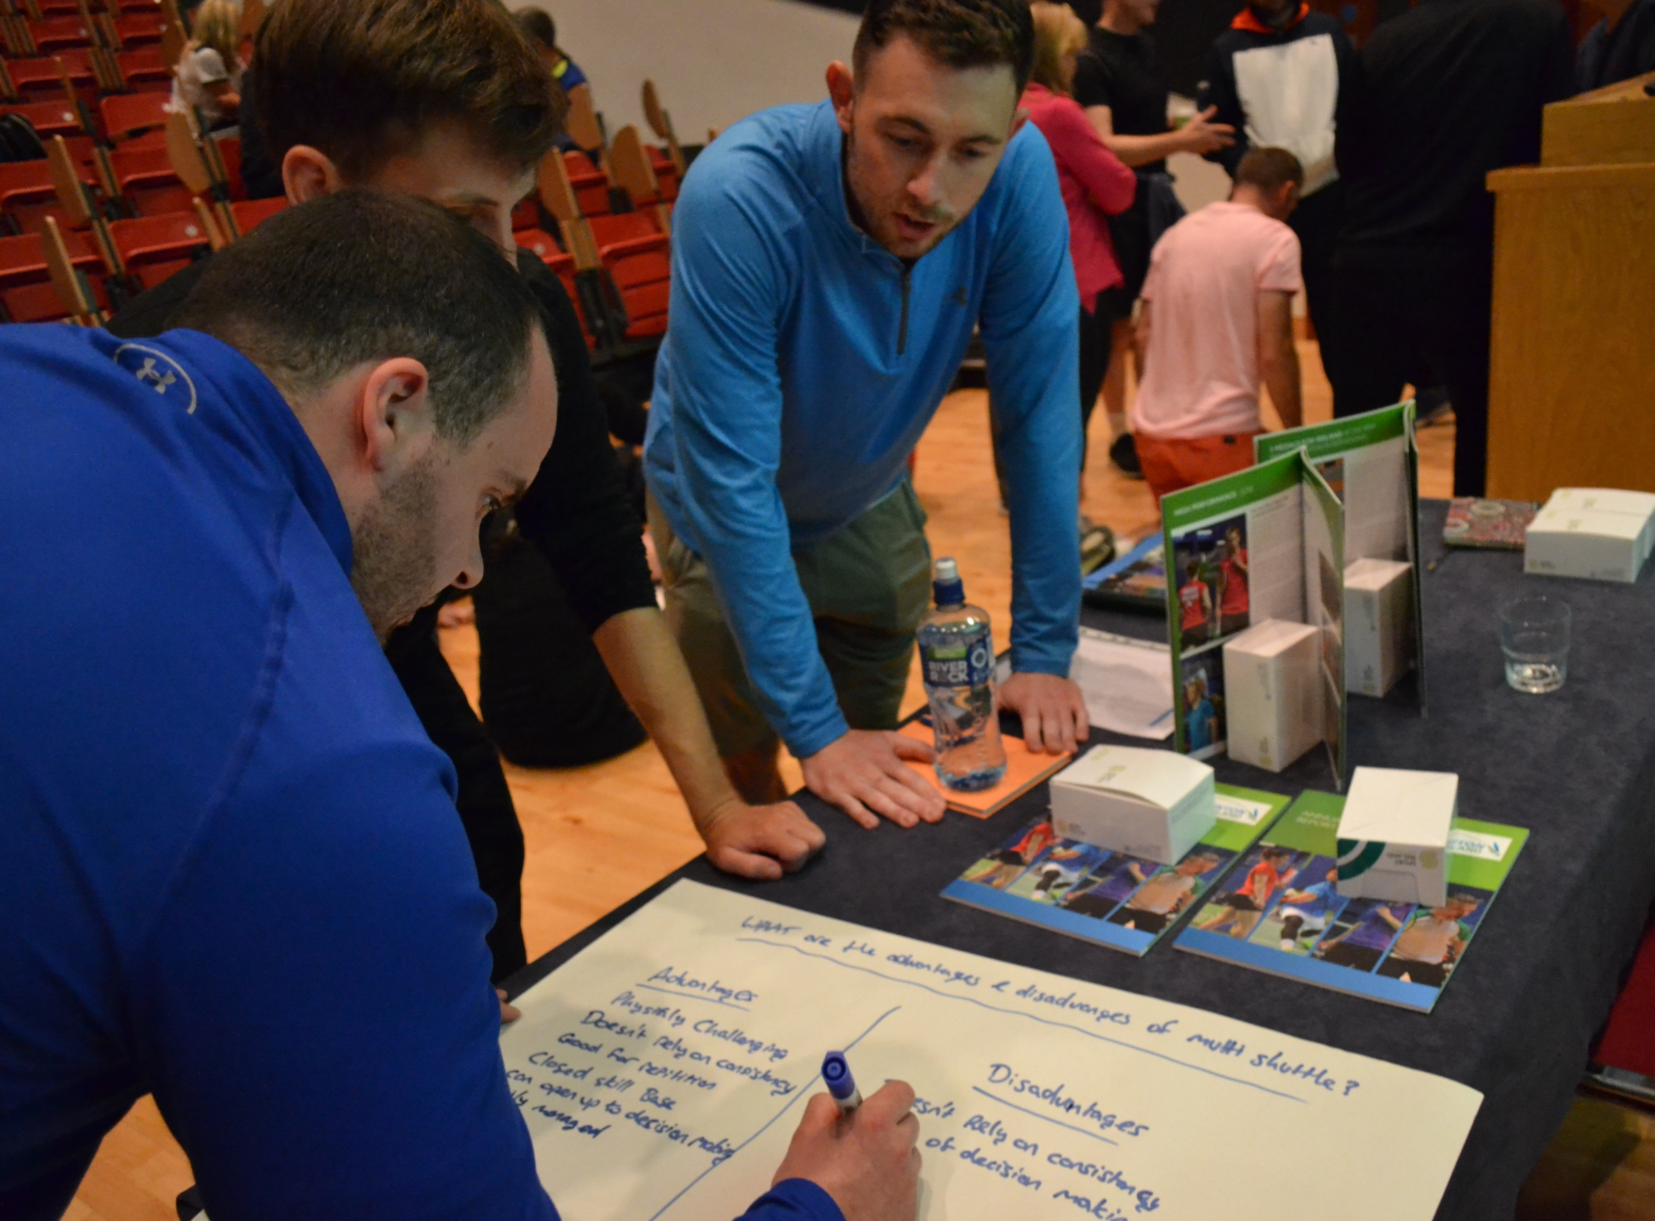
Covid-19 Officer
Necessary to monitor club activity
Role Description
No qualifications necessary
Training Available
No limit on amount of officers
Availability throughout session

Slide 9
Resources

Slide 10
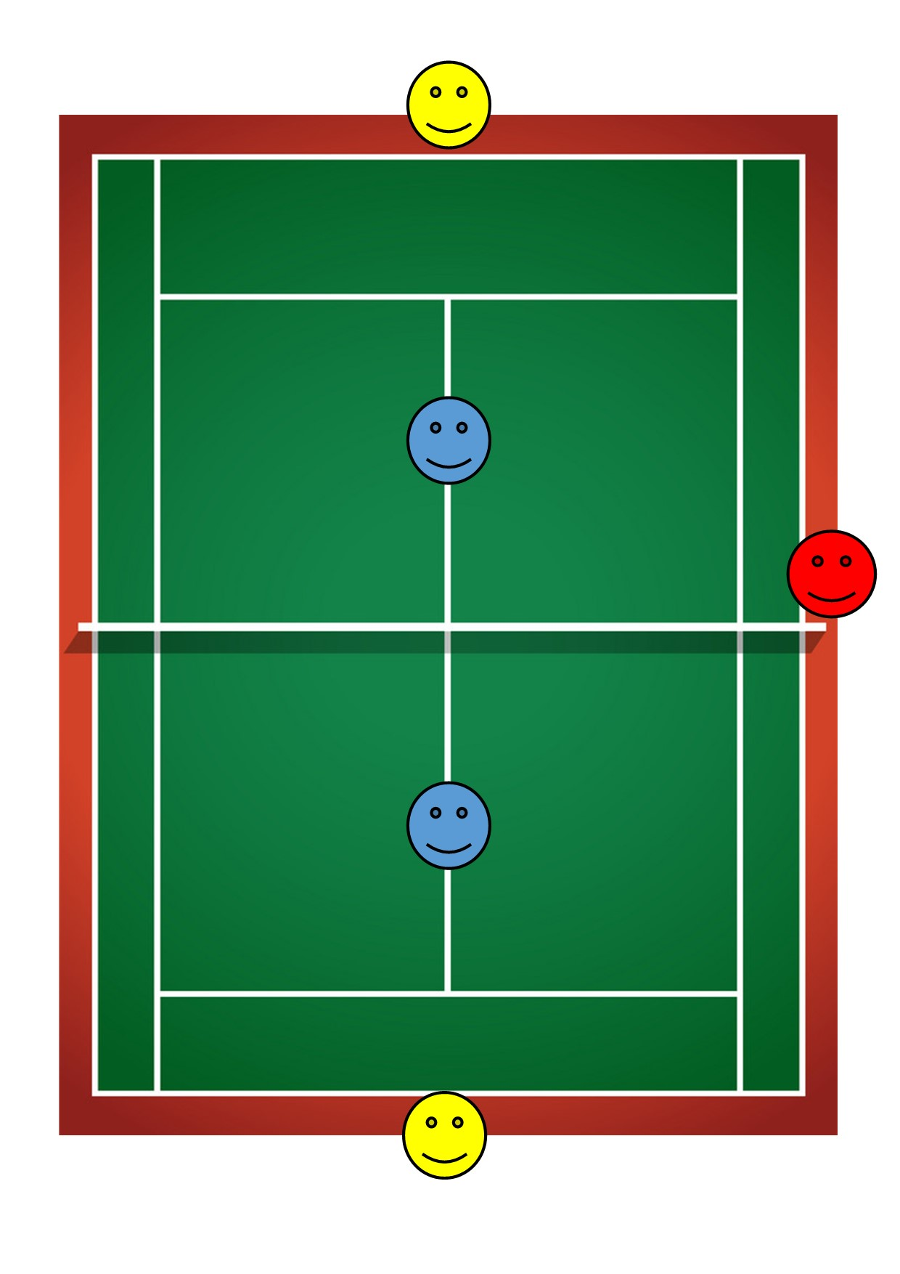
Exit
1 Court Hall
Coach
Players
Parent
Entry
Covid Officer /Supervisor

Slide 11
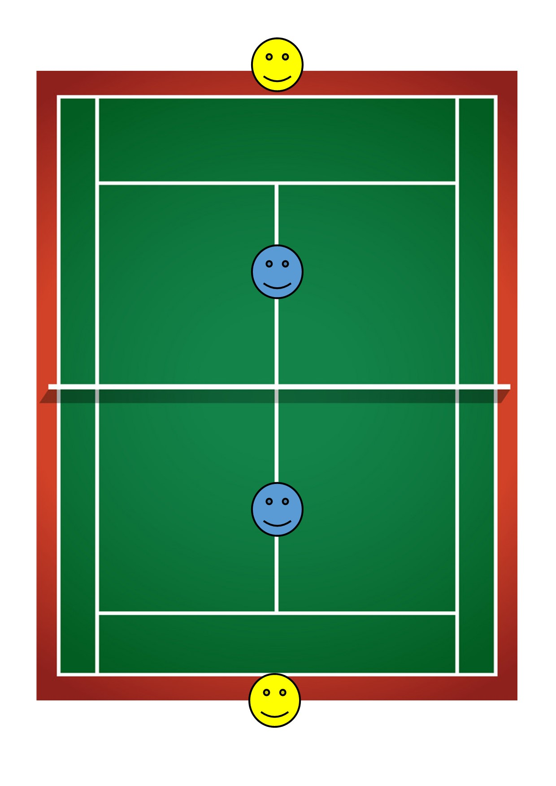
3 Court Hall
Exit
Coach
Players
Parent
Entry
Covid Officer/Supervisor

Slide 12
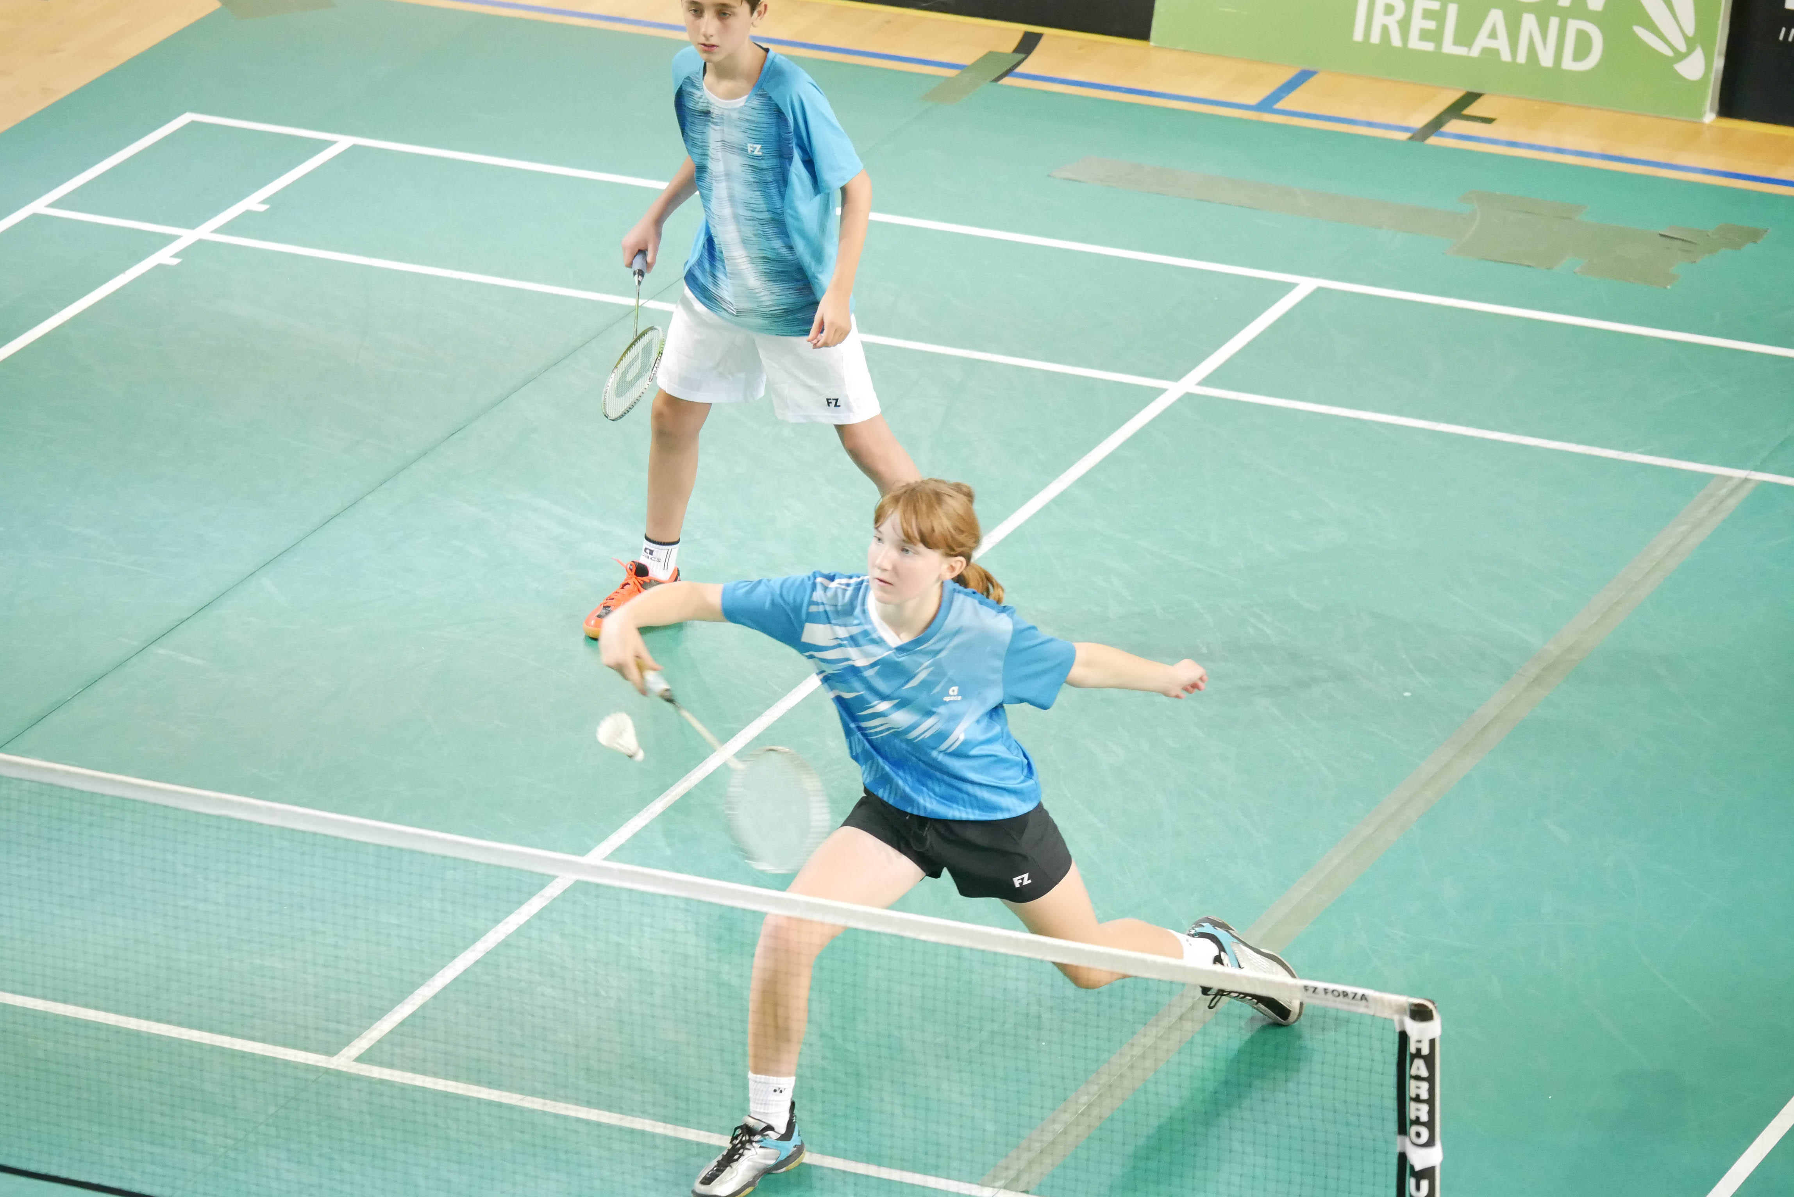
Juveniles
Safeguarding Principles
Access NI / Safeguarding Training
Supervision – Entry /Exit
Induction
Parents - Communication
Contact Details

Slide 13
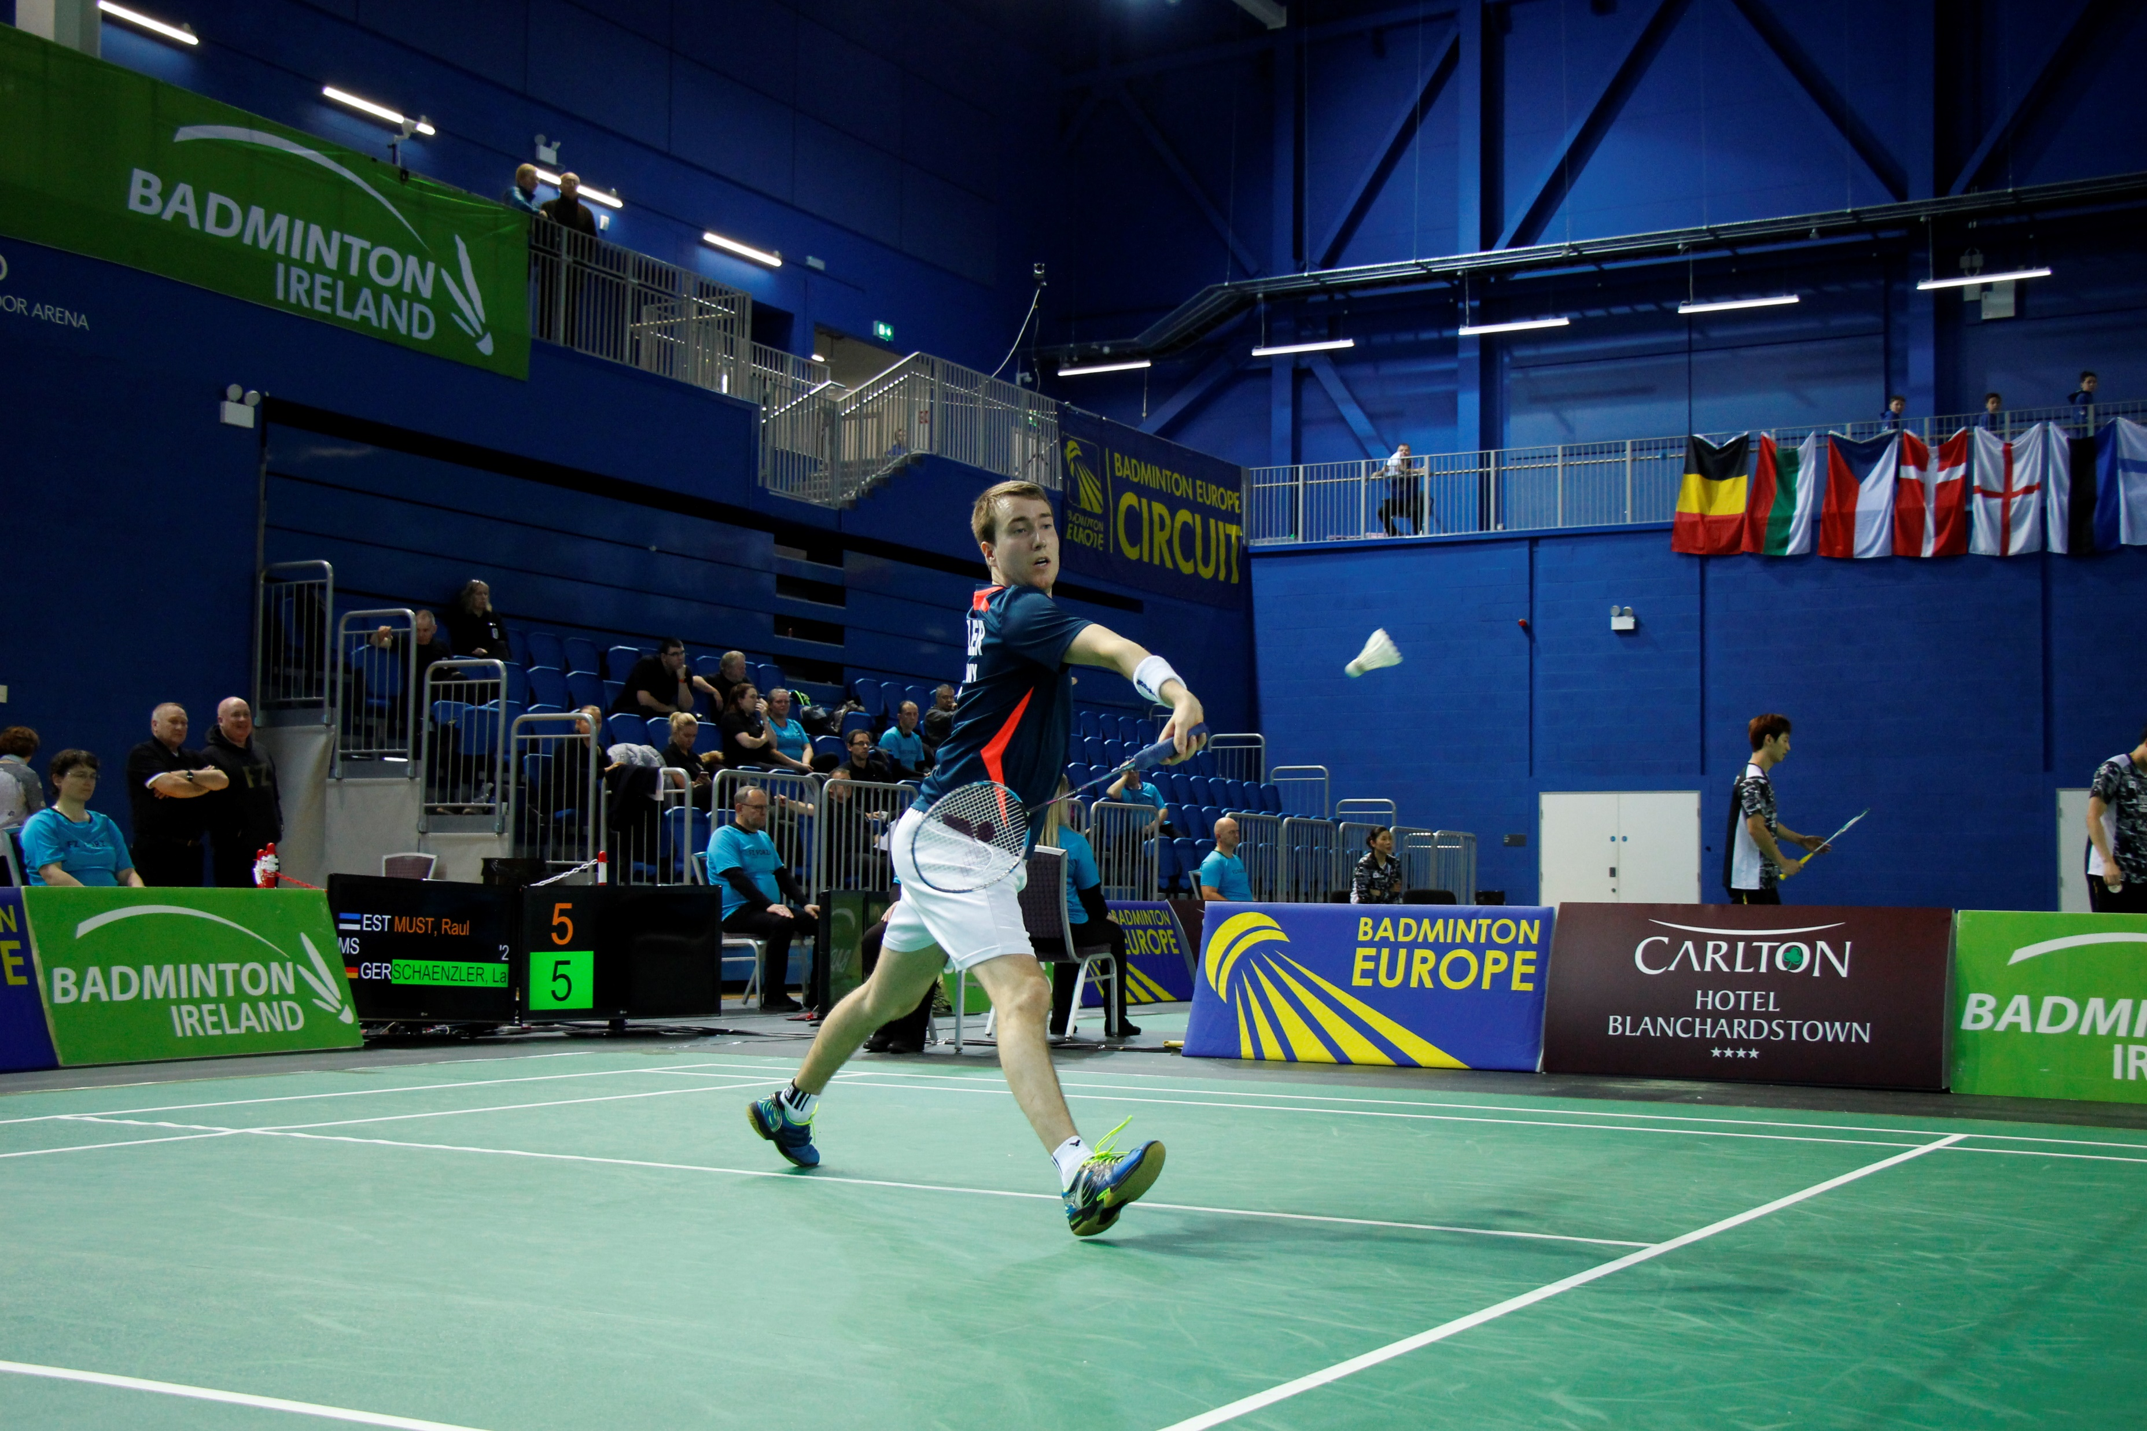
Practical Actions
Venue Provider
Covid-19 Risk Assessment
Disclaimer Form / Blocworx App
Online Response Form for Clubs
Communication with members / Protocols
Induction to players

Slide 14
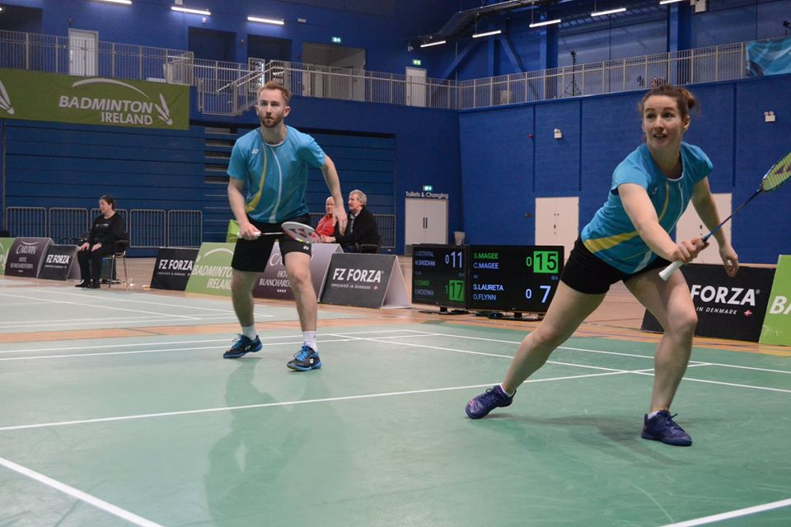
GDPR
Attendance Log
Contact Details are correct
Confidentiality
Storage
Access

Slide 15
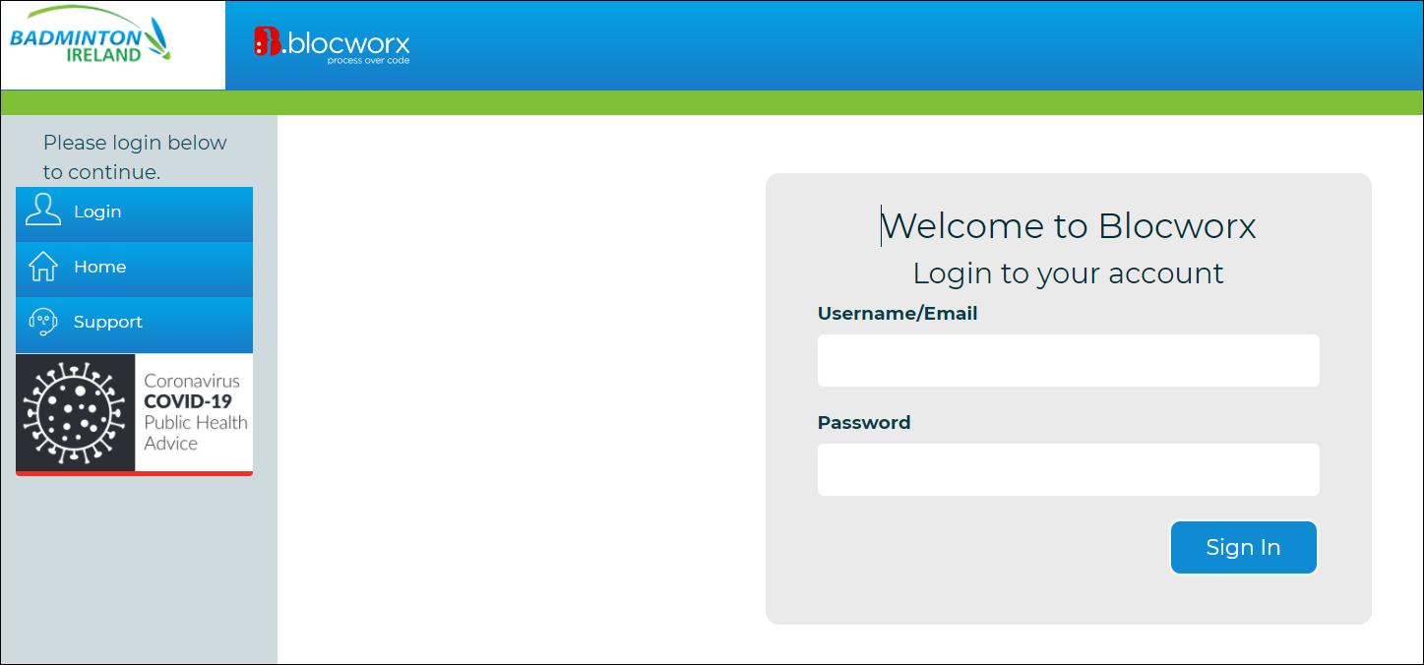
Contact Tracing
Free for all registered clubs
Keep records of attendance
Not an actual app
Members list is already built in

Slide 16
Contact Tracing
Club officer/admin log in VS club member log in
Club admin:
Update member list
Set up training session
Registering players to the session
Filtering data → report
Club members:
Register yourself to the session
Register new member to the session

Slide 17
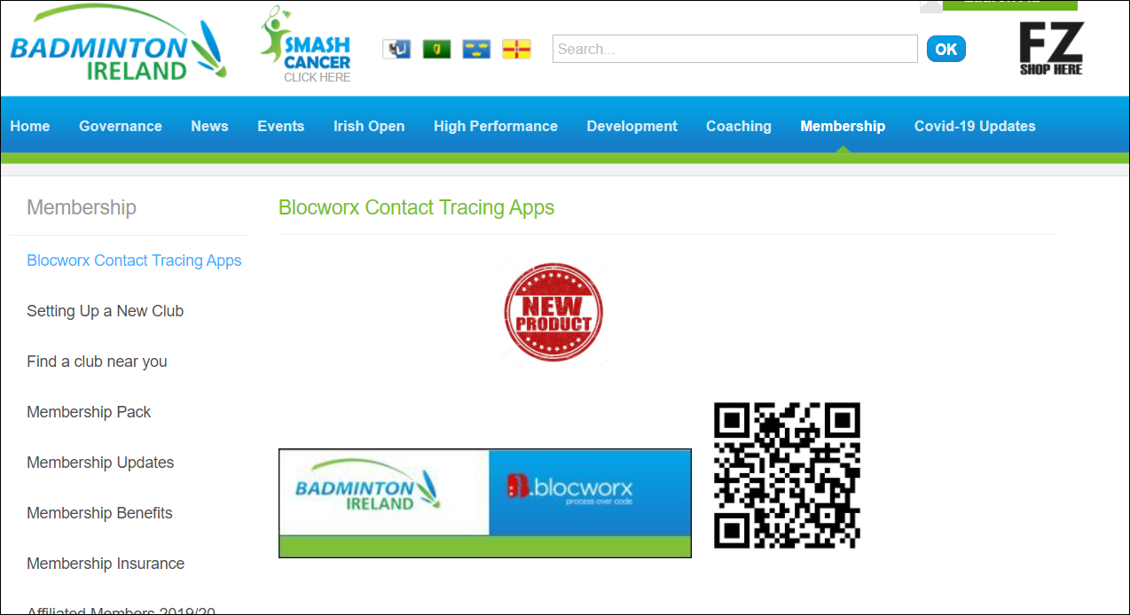
Contact Tracing

Slide 18
Questions?
Contact Details:
Fiach Andrews– Membership & Development Manager (Return to Play Guidelines)
fandrews@badmintonireland.com
Conor Fadian – National Governance Officer (Training, Governance & Club Assistance)
cfadian@badmintonireland.com
Lauren Au – Membership Officer (Blocworx Contact Tracing App)
lau@badmintonireland.com

